Slide 1
Monitoring and Logging in Microsoft Azure

Slide 2
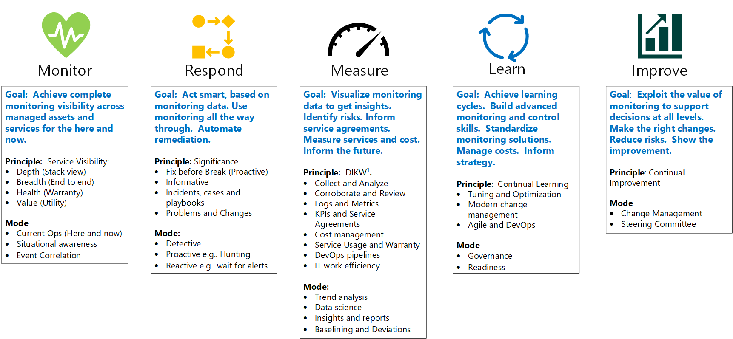
Monitoring Strategy
Notes:
Continuous Monitoring / Continuous Improvement!
Monitor Application Health
Uncover causes of production issues
Measure performance over time
Improve application
Debugging
Manage costs
Compliance

Slide 3
Importance of Monitoring and Logging
Monitor Application Health
Uncover causes of production issues
Measure performance over time
Improve application
Debugging
Manage costs
Compliance
Notes:
Monitor Application Health
Uncover causes of production issues
Measure performance over time
Improve application
Find bottlenecks
Debugging
Manage costs
Compliance

Slide 4
Planning Your Logging Strategy
What should be monitored?
What are your SLAs?
Who should be notified, how, and when?
Data Retention Strategy

Slide 5
Logs and Metrics
Metric:
A Number that represents the state of the system at a point in time
Log:
Record of system or program events persisted to long-term storage for later querying
Notes:
Metrics are numerical values that describe some aspect of a system at a particular point in time. They are lightweight and capable of supporting near real-time scenarios
Logs contain different kinds of data organized into records with different sets of properties for each type. Telemetry such as events and traces are stored as logs in addition to performance data so that it can all be combined for analysis.
Use Metrics to determine health of system
If problem in system, query logs to determine the reason

Slide 6
Traces and Spans
Trace
A single user or service’s journey through the application stack
Collection of Spans
Span
A single piece of workflow (e.g., HTTP request or Database Call)

Slide 7
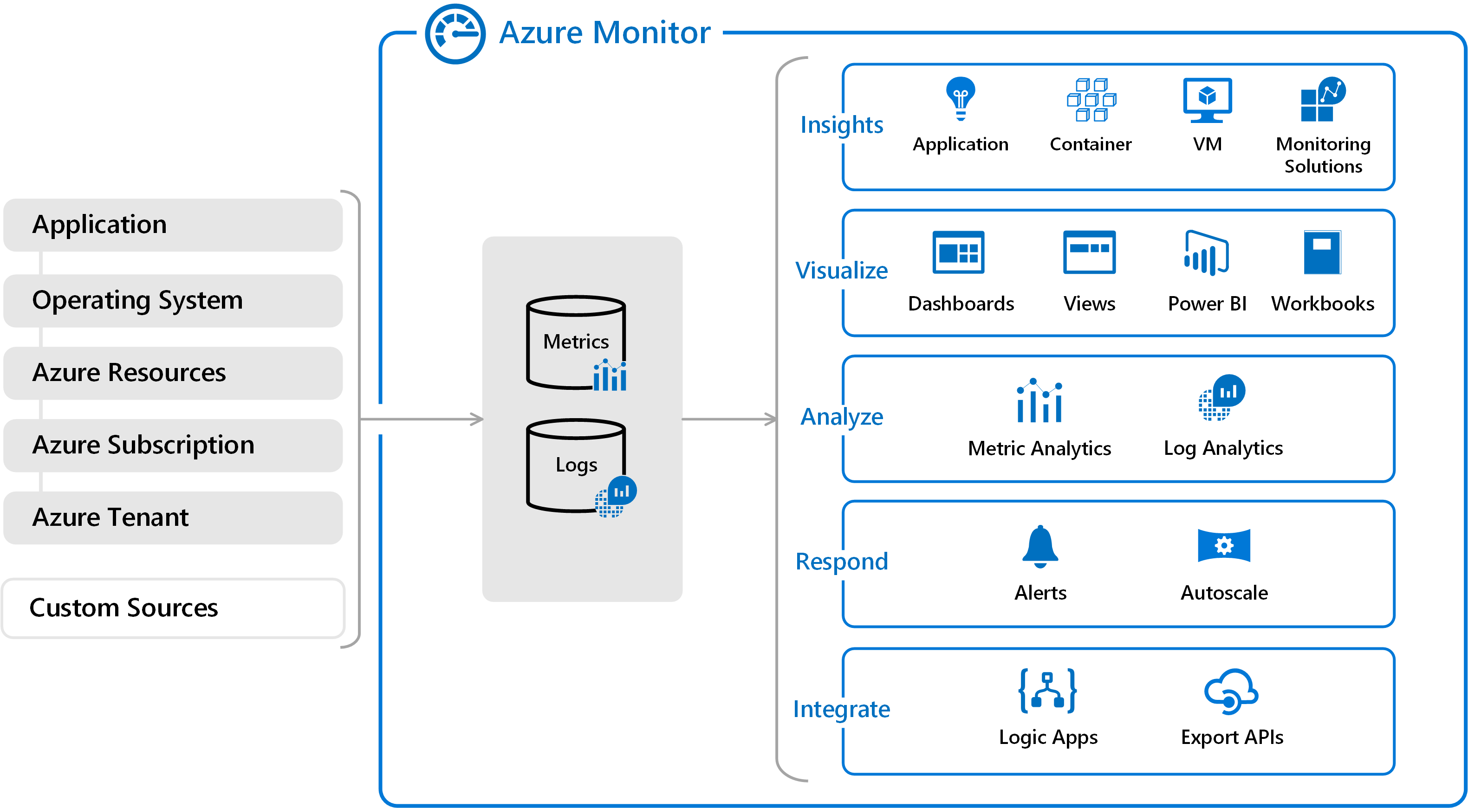
Monitoring and Logging in Azure

Slide 8
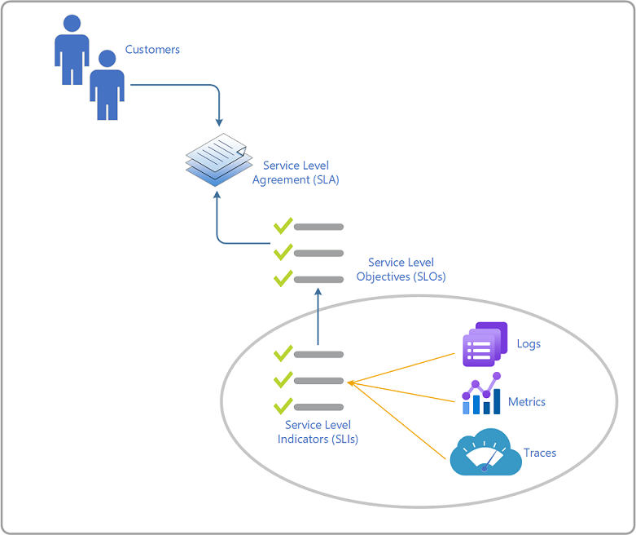
SLA, SLO, SLI

Slide 9
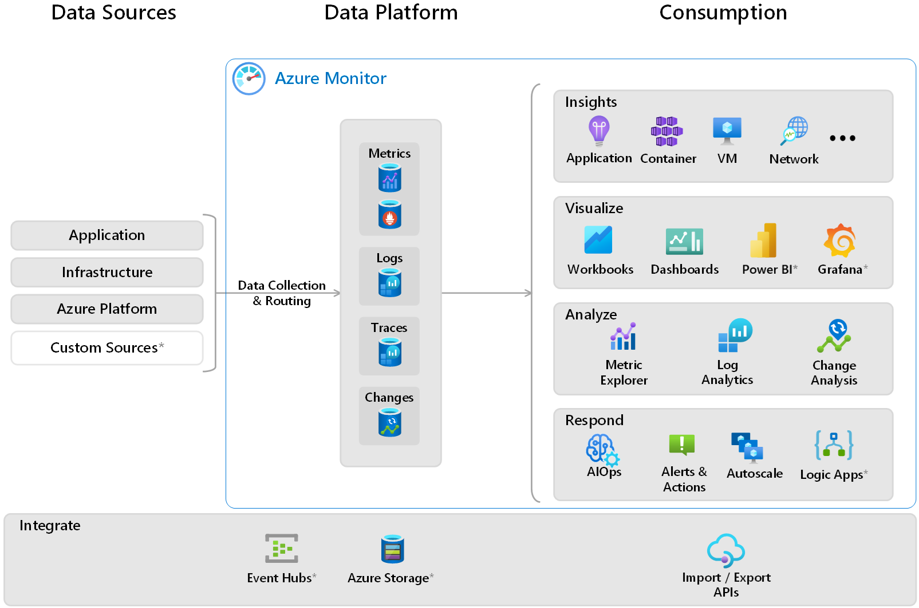
Monitoring and Logging in Azure
Notes:
Cloud monitoring strategy - Cloud Adoption Framework | Microsoft Learn

Slide 10
Collecting Data

Slide 11
Out of Box vs Custom

Slide 12
Azure Monitor
Logging
Metrics
Alerts

Slide 13
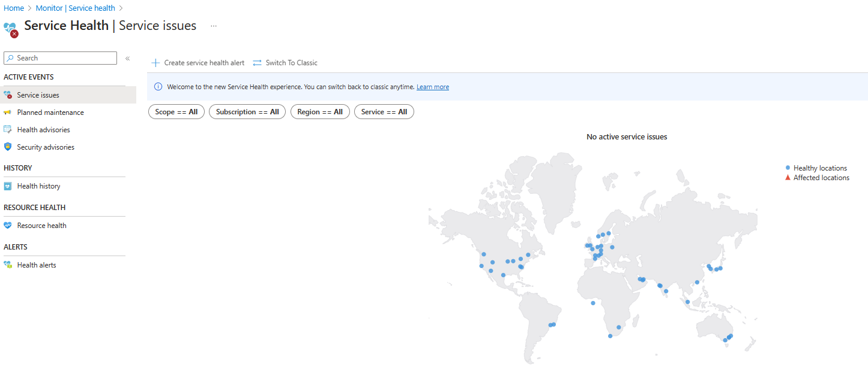
Service Health

Slide 14
Application Insights

Slide 15

Application Insights

Slide 16
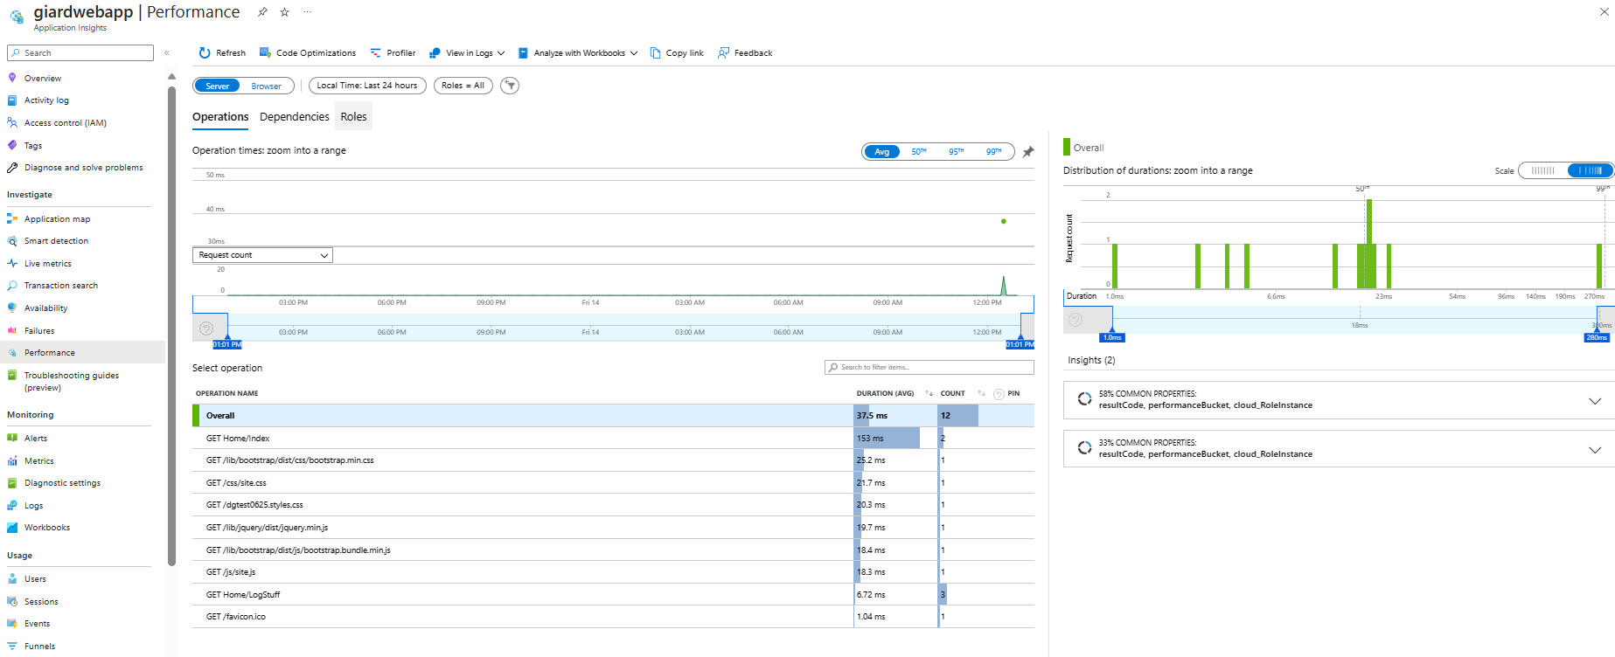
Application Insights Investigate

Slide 17
Demo

Slide 18
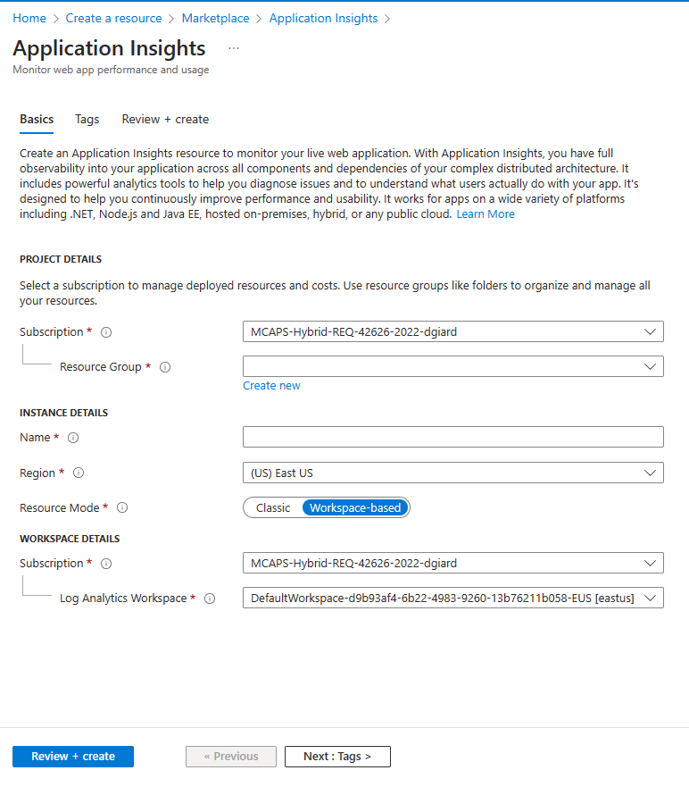
Create Application Insights service

Slide 19
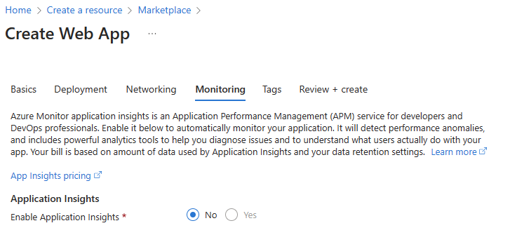
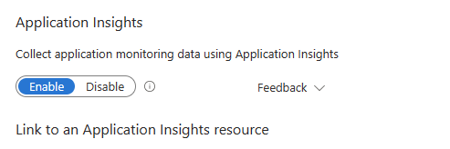
Application Insights: Enable
Enable When Creating
Enable Later

Slide 20
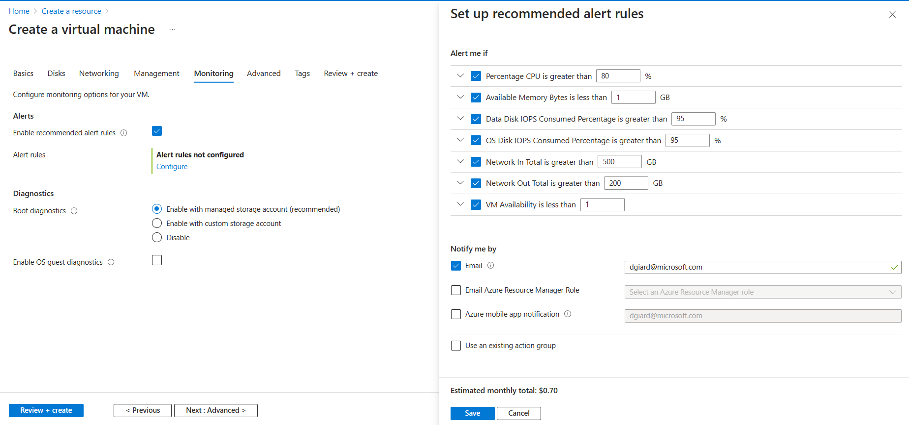
Virtual Machines
Install Application Insights Agent

Slide 21
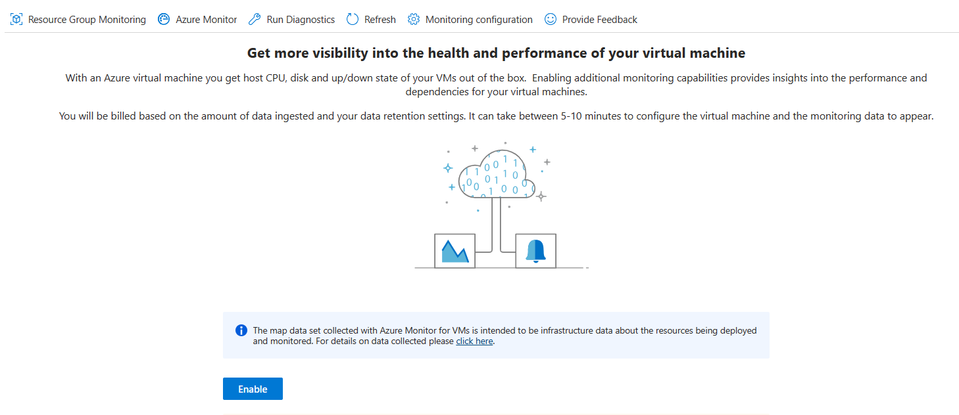
Virtual Machines
Install Application Insights Agent

Slide 22
Application Insights: Log with SDK
Supported Platforms:
ASP.NET
ASP.NET Core
Android
iOS
Java EE
Node.JS
Python
Universal Windows app
Windows desktop applications, services, and worker roles
Notes:
Should I show TelemetryClient example to capture custom metrics?
Application Insights custom metrics with .NET and .NET Core - Azure Monitor | Microsoft Learn

Slide 23
dotnet add package Microsoft.Extensions.Logging.ApplicationInsights --source https://api.nuget.org/v3/index.json

Slide 24
Application Insights: Log with .NET SDK
appsettings.json
{
"ApplicationInsights": {
"InstrumentationKey": "ecce4c22-ac71-4635-8c2e-f8a5eb845e03"
},
"Logging": {
"LogLevel": {
"Default": "Information",
"Microsoft.AspNetCore": "Warning"
}
},
"AllowedHosts": "*"
}

Slide 25
Application Insights: Log with .NET SDK
Startup.cs
builder.Logging.AddApplicationInsights(
configureTelemetryConfiguration: (config) =>
config.ConnectionString = “APP_INSIGHTS_CONNECTION_STRING",
configureApplicationInsightsLoggerOptions: (options) => { }
);
builder.Logging.AddFilter<ApplicationInsightsLoggerProvider>( "your-category", LogLevel.Trace);

Slide 26
Application Insights: Log with .NET SDK
public HomeController(ILogger<HomeController> logger)
{
_logger = logger;
}
_logger.LogInfo("This method called"); _logger.Error(ex.Message);

Slide 27
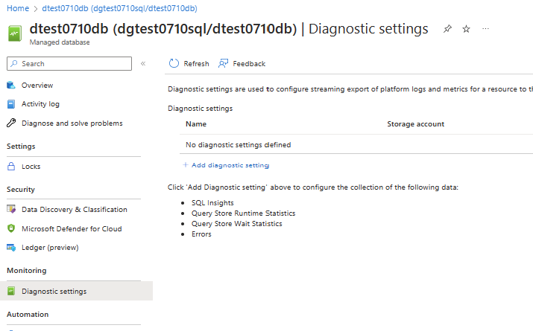
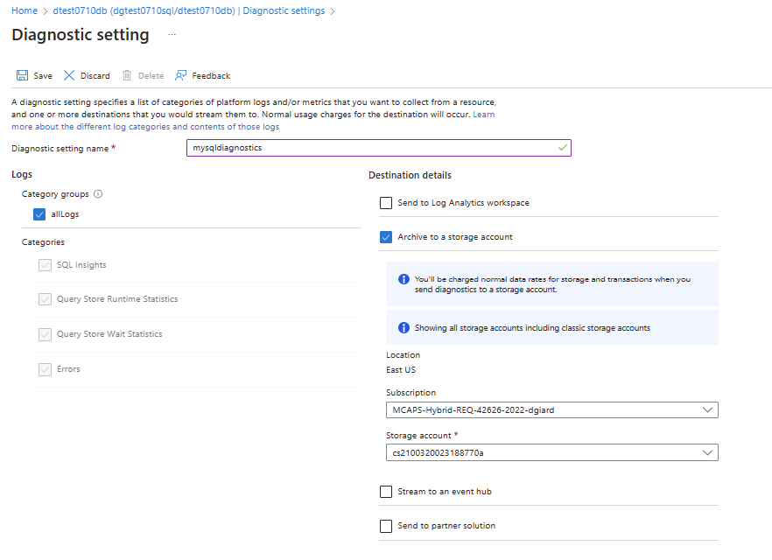
Monitoring SQL Managed Instance
Notes:
Monitoring Azure SQL Managed Instance with Azure Monitor - Azure SQL Managed Instance | Microsoft Learn

Slide 28
Demos
App Insights for App Service
Virtual Machines
SDK Code

Slide 29
Alerts

Slide 30
Application Insights Alerts
Notification of anomaly
React quickly
Signal
Condition
Action

Slide 31
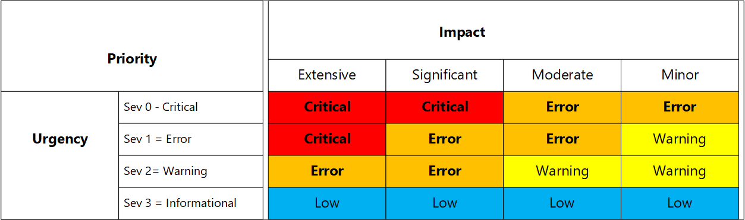
Prioritizing Issues

Slide 32
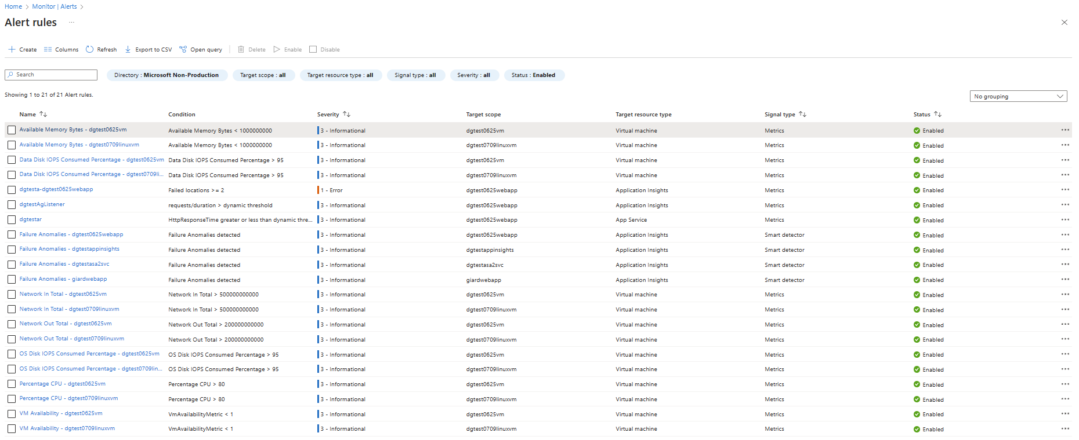
Alert Rules

Slide 33
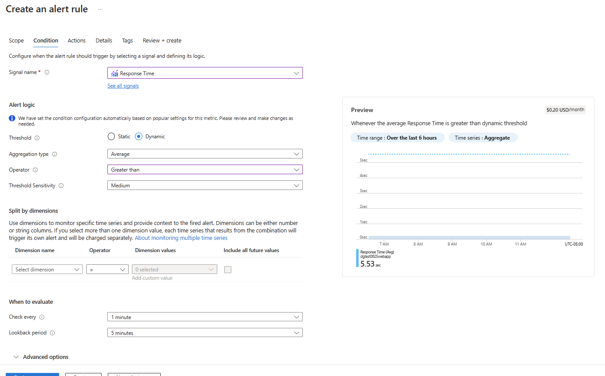
Creating Alerts

Slide 34
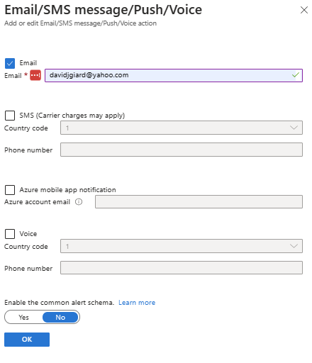
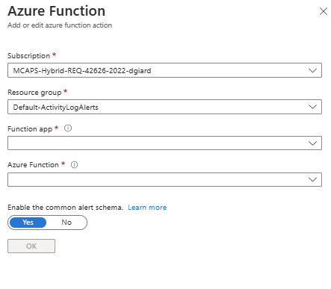
Action Groups
Define Notifications and/or Actions

Slide 35
Demo: Create Alert
Notes:
“Alerts” blade
[Create Action Group] button
[Create alert rule] button

Slide 36
Analyzing and Reporting

Slide 37
Types of Events

Slide 38
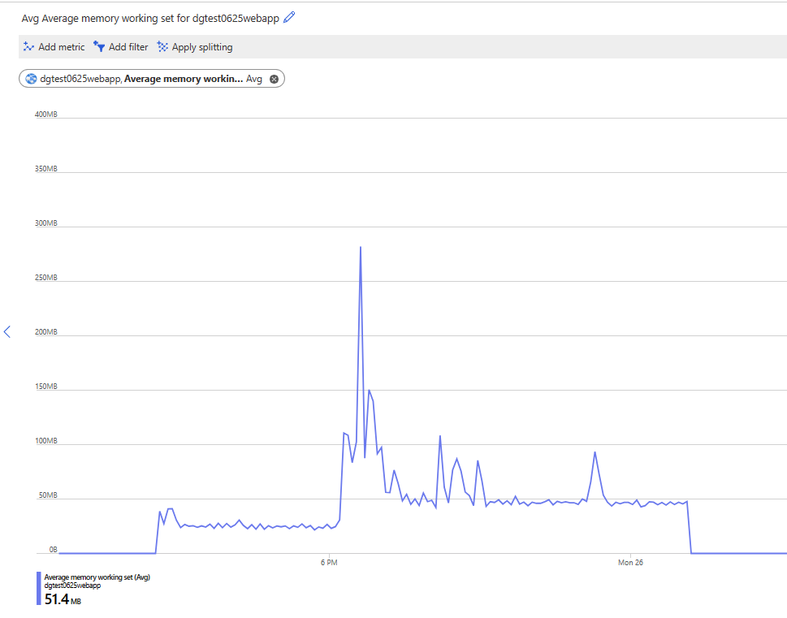
Metrics

Slide 39
Demo: Metrics
Notes:
“Metrics” blade
Select Chart
Add New Chart

Slide 40
Log Analytics Queries

Slide 41
KQL Overview
// Page views trend
// Chart the page views count, during the last day.
// To create an alert for this query, click '+ New alert rule'
pageViews
| where client_Type == 'Browser'
| summarize count_sum = sum(itemCount) by bin(timestamp,30m)
| render timechart
Filtering
Sorting
Aggregating
Top N queries
Functions
traces
| order by timestamp desc
| project timestamp, operation_Name, message, severityLevel

Slide 42
Demo: KQL
Notes:
“Logs” blade
Show built-in query
Build new query: filter, sort, take, project, where

Slide 43
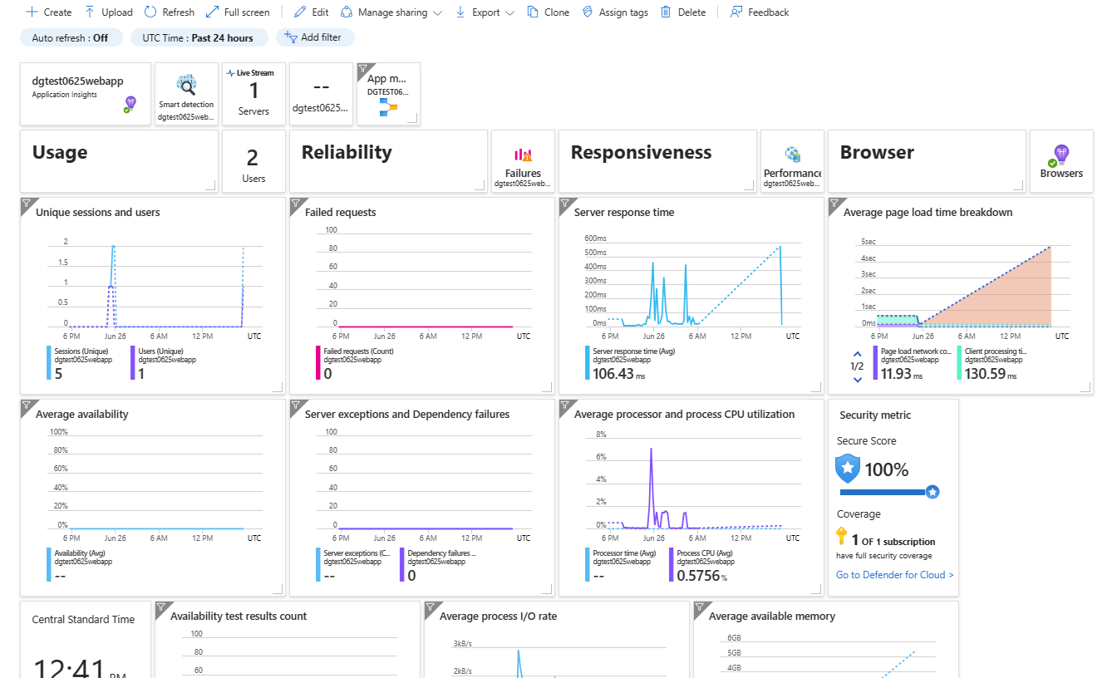
Dashboards
Notes:
Recommendation: 1 dashboard per component
Dashboard drill-down
Azure Portal | Monitor | Application Insights: App | giardwebapp
[Application Dashboard] button

Slide 44
Demo: Dashboard
Notes:
“Application Insights” blade
“View Application Insights Data” link
[Application Dashboard] button
Explain dashboard
[Edit] button
Add tile
Move tiles
Delete tile

Slide 45

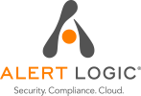




















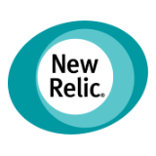

Integration With Other Applications

Slide 46
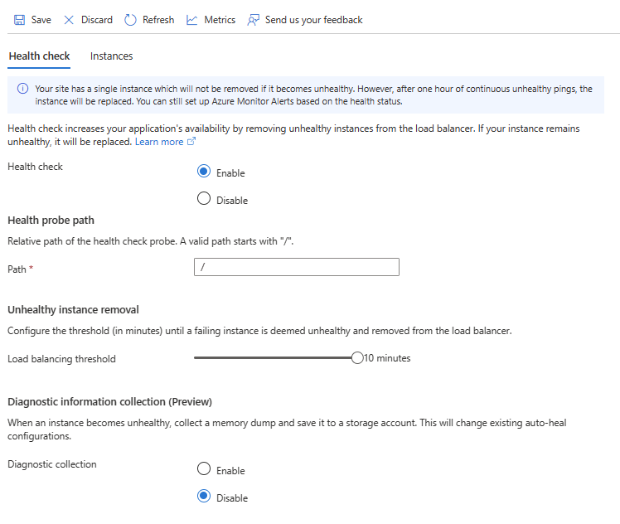
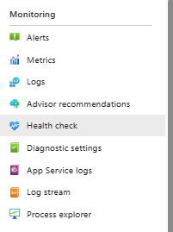
Health Check
Available in App Service
Remove instances from Load balancer if unhealthy for x minutes
Requires Standard or Premium Plan
Notes:
This is available within an App Service under the “Monitoring” section of the left menu

Slide 47
Diagnostics Settings
Log Analytics Workspace
Archive to Storage
Stream to Event Hub
Send to Partner Solution

Slide 48
Diagnostics Settings Demo
Notes:
Azure Monitor | Diagnostic settings blade
Select Log Analytics Workspace
[Add diagnostic setting] button
[x] Archive to a storage account checkbox

Slide 49
Pricing
Pricing - Azure Monitor | Microsoft Azure

Slide 50
Recommendations
Configure Autoscaling
Alerts to Learn of Issue; Logs to Find Reasons for Issue
Only Create Actionable Alerts
Create an Archive Strategy

Slide 51
More Info
https://learn.microsoft.com/azure/azure-monitor
https://azure.microsoft.com/products/monitor
https://davidgiard.com/azure-monitoring-articles
https://youtube.com/playlist?list=PLod9m2rk9ce7-evl3sHlEN34egQFpNwQ3

Slide 52
Questions

